Slide 1
IAS19 discount rates in the time of Covid-19
Peter Devlin, Deloitte Consulting, Germany
May 11th – May 15th 2020

Slide 2
About the speaker
Peter Devlin
Partner, Deloitte Consulting GmbH
Authors include Paulwin Graewe, Hartmut Moormann, Reinhard Schmidt and Christine Steiner
Deloitte
Deloitte provides audit, risk advisory, tax, financial advisory and consulting services to public and private clients spanning multiple industries; legal advisory services in Germany are provided by Deloitte Legal. With a globally connected network of member firms in more than 150 countries, Deloitte brings world-class capabilities and high quality service to clients, delivering the insights they need to address their most complex business challenges.

Slide 3
Determination of discount rates
IAS19 only includes a description how the discount rate has to be determined. However, there is not the “one and only” correct method to do this.
Under IAS19.83 the rate used to discount post-employment benefit obligations (both funded and unfunded) shall be determined by reference to market yields at the balance sheet date on high quality corporate bonds.
In countries where there is no deep market in such bonds, the market yields (at the end of the reporting period) on government bonds shall be used.
The currency and term of the corporate or government bonds shall be consistent with the currency and estimated term of the post-employment benefit obligations.

Slide 4
How good is that high quality bond?
Requirements for high quality corporate bonds
Discount rates should be determined by reference to market yields on high quality corporate bonds. At its November 2013 meeting, the IFRS Interpretations Committee issued a final rejection notice stating that an entity should take into account the guidance in paragraphs 84 and 85 of IAS 19 (2011) in determining what corporate bonds can be considered as high quality corporate bonds:
The discount rate does not reflect the entity-specific credit risk
The discount rate reflects the time value of money but not the actuarial or investment risk
The discount rate reflects the currency and the estimated timing of benefit payments
The discount rate does not reflect the risk that future experience may differ from actuarial assumptions

Slide 5
How others see the issue
Requirements for high quality corporate bonds. Observations by the IFRS Interpretation Committee
Paragraph 83 of IAS 19 uses the term ‘high quality’ which reflects an absolute concept of credit quality and not a concept of credit quality that is relative to a given population of corporate bonds
Based on the understanding of “deep market” the national accounting boards in Norway and Sweden concluded in 2013 that the covered bonds market should be used as a basis for setting the discount rate. Covered bonds have typically a rating of AA or higher.
In Switzerland rates are based on a high quality corporate bonds and government bonds or hypothetical AA rated yield curves.
Grade of bonds
§ 83 IAS 19
Consequent
IAS 19 does not specify how to determine the market yields on high quality corporate bonds, and what grade of bonds should be designated as high quality
‘high quality’ reflects an absolute concept of credit quality and not a concept of credit quality that is relative to a given population of corporate bonds
The concept of high quality should not change over time, and accordingly
A reduction in the number of high quality corporate bonds should not result in a change to the concept of high quality.

Slide 6
How others see the issue
Requirements for high quality corporate bonds. Further notes by the IFRS Interpretations Committee
Continuous chose of methods
Identification of bonds
An entity’s methods and techniques used for determining the discount rate should not change significantly from period to period.
The identification of the high quality corporate bonds population used as a basis to determine the discount rate requires the use of judgment, and that if this judgment has a significant effect on the entity’s financial statements, IAS 1.122 requires an appropriate disclosure about the judgment made.
In their recommendation for 2013 financial statements, the ESMA has emphasized this decision and concluded that it did not expect significant changes in the methods and techniques to determine the discount rate.

Slide 7
Can one extrapolate to the right discount rate?
IAS 19 does not provide any further guidance on the meaning of the term 'high quality corporate bonds'. In practice, the term is generally taken to refer to corporate bonds with one of the two highest ratings from a recognized rating agency in jurisdictions in which such an agency exists.
It is our view that the determination as to whether a deep market for high quality corporate bonds exists is based on the economy in which the retirement benefit plan is located and whether the bonds are considered high quality in that economy. (This may become an issue, as in the past, where the Euro-area covers multiple countries.)
IAS19R.83 and IAS19R.86 apply in a situation where no deep market exists in bonds with sufficiently long maturities and require that an entity uses current market rates of the appropriate term to discount shorter-term payments and estimates the discount rate for longer maturities by extrapolating current market rates along the yield curve. In situations where no deep market exists at all, the market yields on government bonds should be used.
In practice there exists a variety of methods used by actuarial firms (like extrapolation methods or yield curves based on swap curves or government bond curves plus a credit spread adjustment) or national interpretations.

Slide 8
When does IAS8 come into play?
Accounting Policies, Changes in Accounting Estimates and Errors
Does the change in IAS19 rate method count as a change in estimate or a change in accounting policy?
Issue | Definition | Requirement | Impact on the reporting | Our example
Change in accounting policy | Accounting policies are the specific principles, bases, conventions, rules and practices applied by an entity in preparing and presenting financial statements. | The company has to provide reasons, why the meaningfulness of the annual accounts will improve given the change in the policy. | The impact on the liability amounts for the current period and previous periods as far as it is possible must be determined. | Change in the way to draw the yield curve (eg this could often appear if a company uses the methodology of its actuary and a new actuary is engaged)
Change in estimate | Changes in accounting estimates result from new information or new developments and, accordingly, are not corrections of errors. | No specific requirements. | The impact on the liability amount for the current period is included in the IAS8 reporting. | Refine the definition which bonds will be considered as the basis for the yield curve
According to IAS8 if it is not possible to decide as to whether a change is a change in the accounting method or a change in estimates the standard says that it is then a change in estimates.
Based on our experience we have never seen a change in the proposed methodology to determine the discount rate qualified as change in accounting method. This is probably a result of the definition being too vague. For this reason the IASB is working on a change in the IAS8 standard in order to provide a better guideline to distinguish between changes in accounting policy and changes in estimates. What point does a series of small changes (in estimates) become a change in accounting policy?

Slide 9
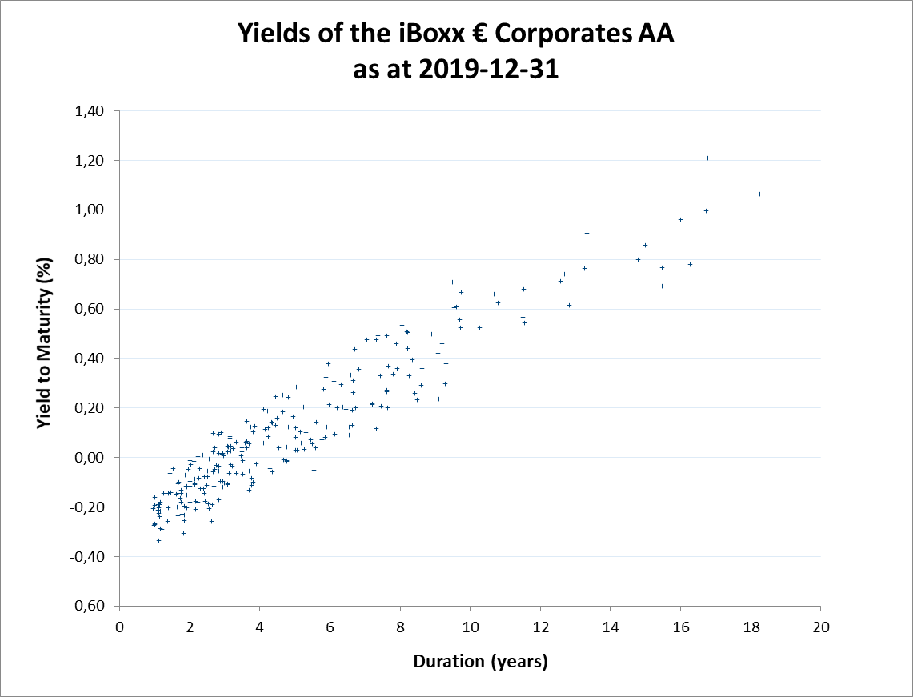
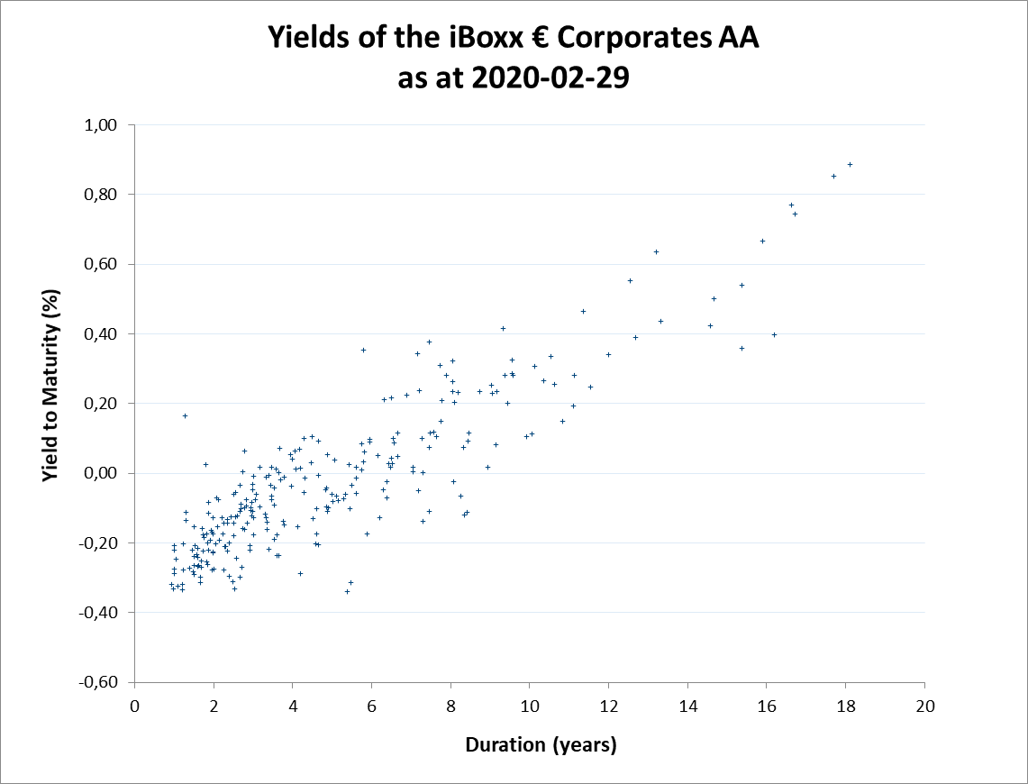
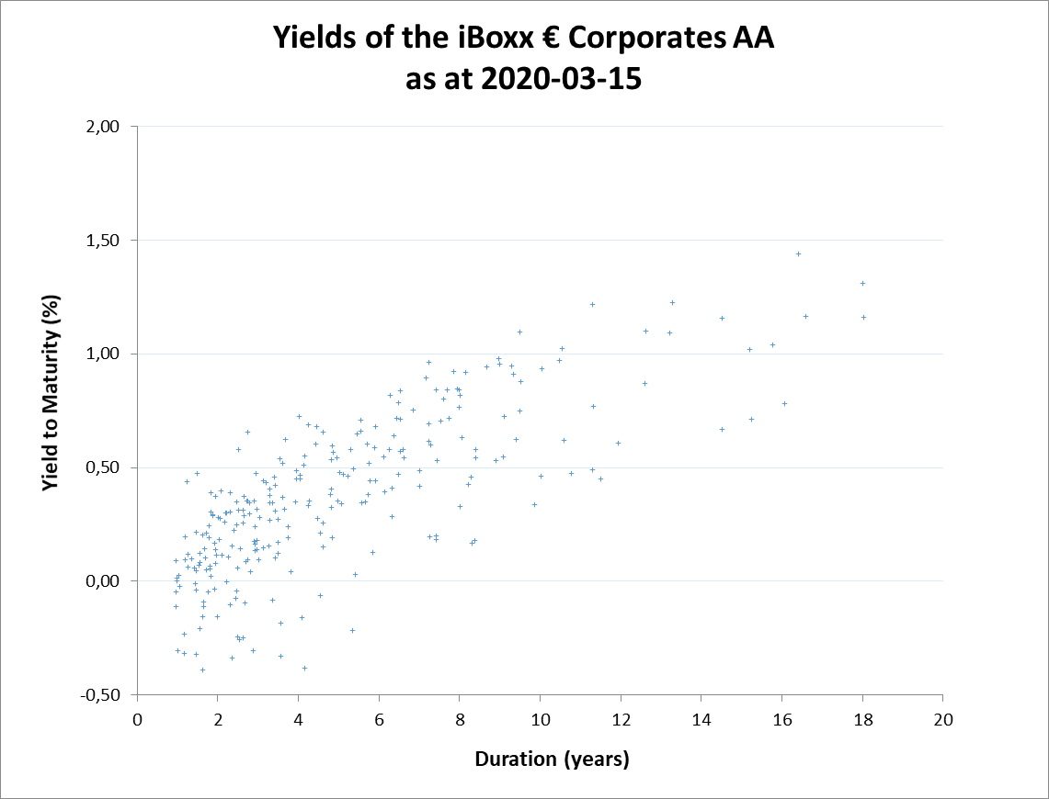
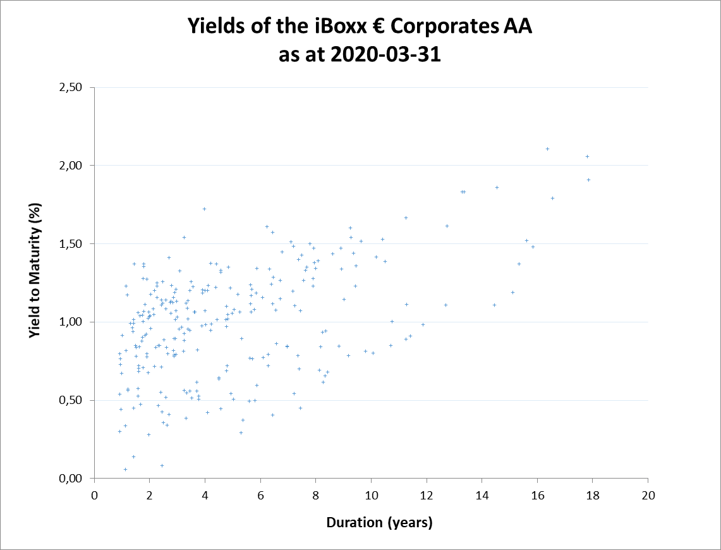
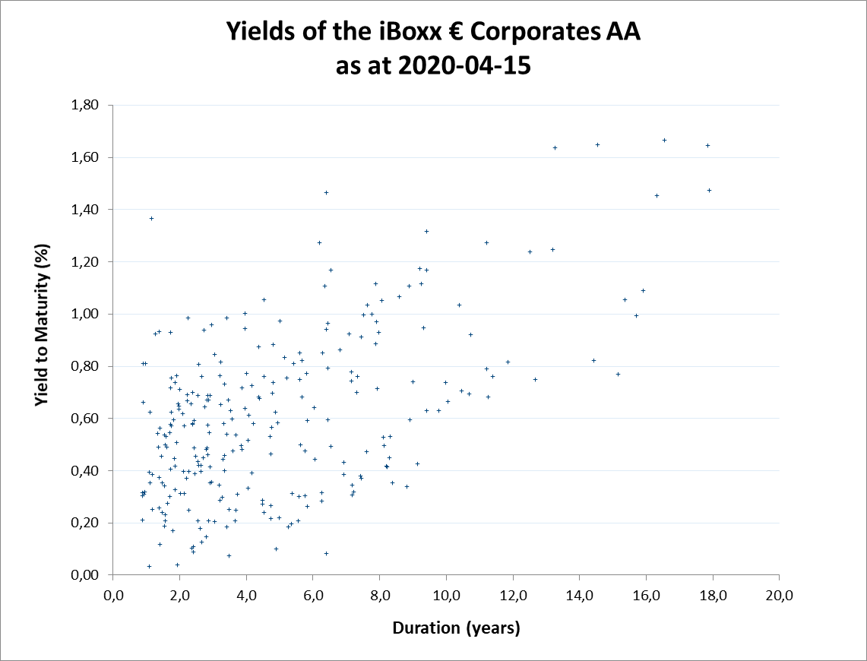
Corporate yields in the Corona crisis
In March 2020 the yields of AA rated corporates bonds in the Euro-Zone increased significantly. This increase due to an increase in market risk premiums during Corona crisis. We have observed a much higher distribution of yields.
Yields of the iBoxx € Corporates AA
The iBoxx € Corporate AA index is generally accepted as a benchmark portfolio for selecting discount rates in accordance with IAS19.78 for the valuation of pension obligations in the Euro-Zone.
We observed that Corona crisis leads to a significant drop in rates. It is not possible to say whether the current spike in yields is a short-term issue or indicating a fundamental change in the market.
We observe a scattering of the yield cloud into two sub-clouds, which might be interpreted as “true AA” bonds and a group of bonds which could be downgraded in near future.
There are currently discussions about whether the latter group could be excluded from the bond universe. We believe that this is not warranted (the same discussion took place after the finance crisis).

Slide 10
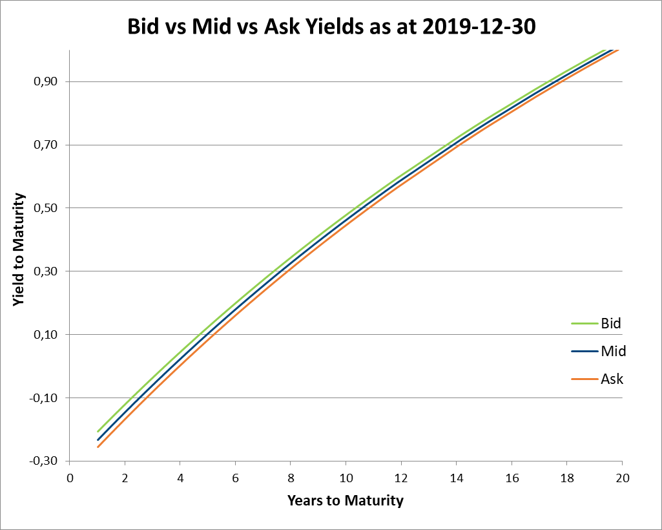
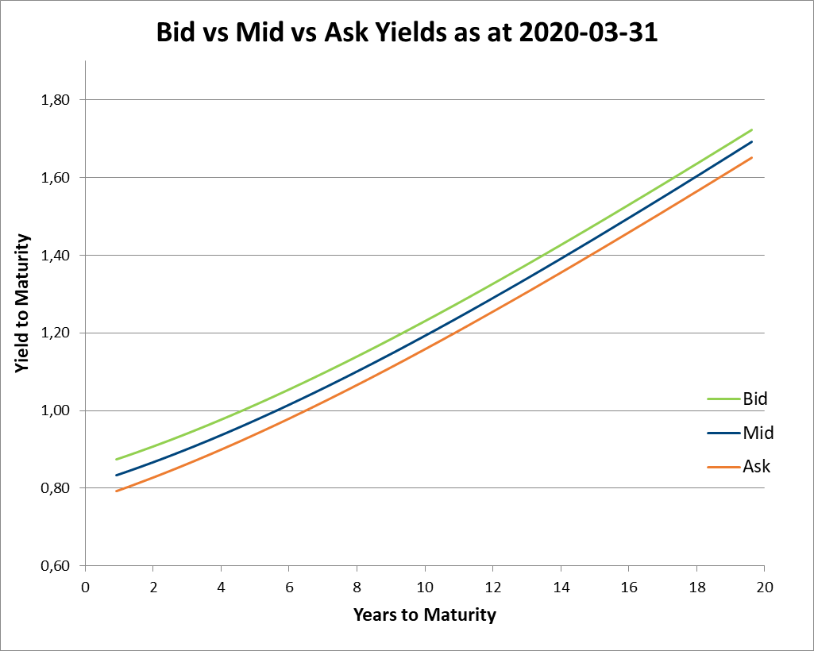
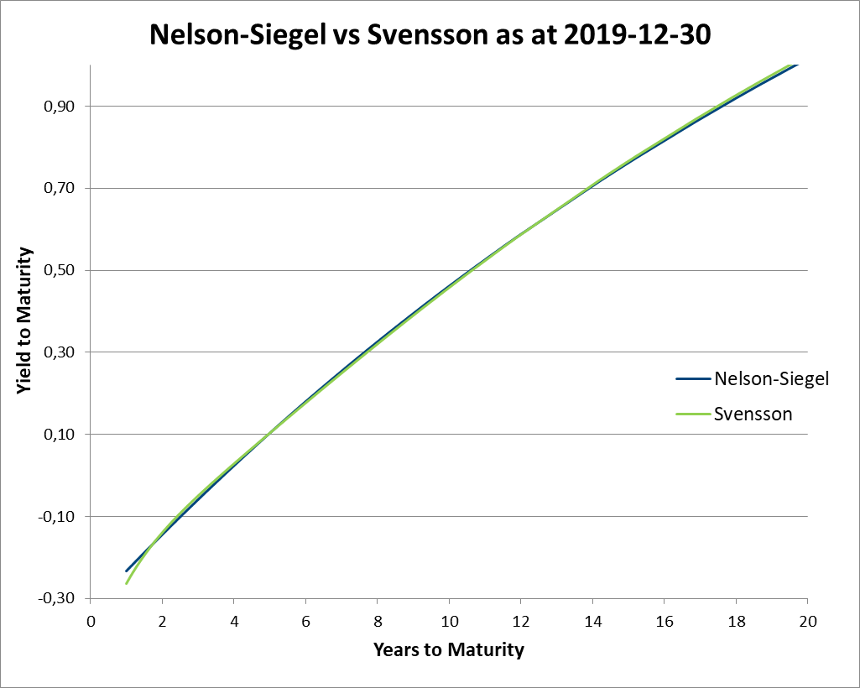
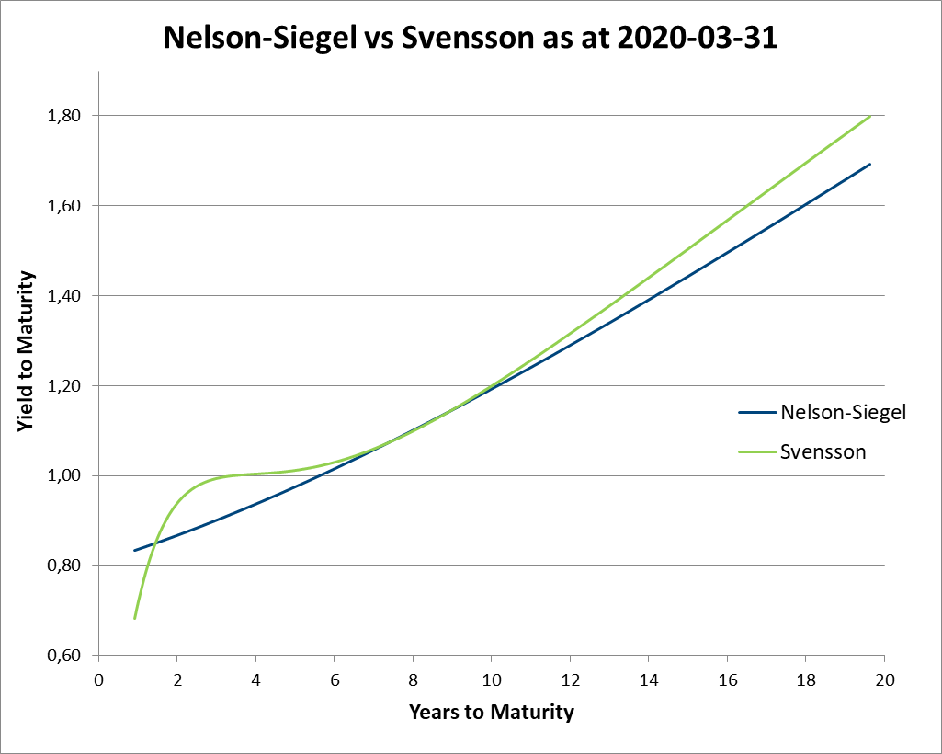
Methodology aspects
Several choices of methodology with minor effects under stable market conditions have now become a relevant factor when determining discount rates in the Corona crisis. Actuaries need to choose the “right” methods carefully.
Bid vs Mid vs Ask Prices
There has always been the debate of whether bid, mid or even ask prices should be used when determining discount rates under IAS 19.
While the effects under stable market conditions (left) were rather negligible spreads of corporates bonds in the Corona crises have increased significantly (right).
Nelson-Siegel vs Svensson interpolation
There are several generally accepted methods to interpolate and extrapolate yield curves from the bond clouds, e.g. polynomial approach, Nelson-Siegel approach and Nelson-Siegel-Svensson approach.
Under stable market conditions as at 31 Dec 19 the classical Nelson-Siegel approach and its extension by Svensson lead to almost identical curves (left hand).
In times of Corona, we see very different shapes for these two approaches.
Further aspects
Covered bonds vs uncovered bonds. If covered bonds are used (which was accepted for many years), Corona impact is too small to lead to changes in method (IAS8).
Market data reliability (e.g. given by the reliability scores BVAL from Bloomberg or TRPS from Thomsen Reuters) decreased significantly during the crisis.

Slide 11
Expected inflation
Inflation is another relevant driver for pension obligations. Many actuaries use ECB target of (below but close to) 2.00%, actual (smoothed) inflations or survey-based inflations. We prefer a more market-orientated approach as this is required under IAS 19 and fulfill mutual consistency requirements
Inflation in the Euro-Zone
In the last years inflation in Euro-Zone has been below the ECB target of “below but close to 2.00%”.
There are many opinions as to whether the Corona crisis will lead to a significant drop in rates or an increase.
Mainly there are two different ways to predict inflation. Survey-based measures and market-based measures. We would always suggest a market-based approach as this is required under IAS 19.
Looking at the gap between the yields on fixed-interest government bonds (15 years term) and the yield on inflation-linked bonds (15 years term), our forecast inflation rate is shown in the adjacent graph in orange. The actual inflation is shown in blue. The formula is open to refinements but gives a market view that is the requirement.
An application: Pension increases in Germany
If there is no guarantee fixed in the pension plan, companies in Germany are required to increase pensions by inflation. Where pension increase rates are fixed (e.g. 1% p.a.), the fixed rate should be used.
Actuaries in Germany tend to use pension increase rates of 1.75% to 2.00% in order to take account of the ECB inflation target of “somewhat below 2.00%” (if your actuarial valuation system uses projected cash-flows with correct increases and not annuity values at retirement then this is not needed!). From our point of view, this approach is too prudent as it neither reflects current inflation nor inflation expectations (graph on the upper left).
Furthermore, according to German legislation, companies in Germany are only required to review pension payments every three years and to increase pensions according to the change in the cost-of-living index, if the financial situation of the company allows for it.
Where pension increases are made every three years in line with Section 16 BetrAVG then the rate of pension increase should be the expected inflation rate less 0.25% to take account of the three year lag in increases (graph on the lower left).
In Corona crisis another aspect comes into play. German Pension Act more precisely states that pension must be adjusted in line with the lower of the change in the cost-of-living index and the realized salary increases for the company. As many companies will be hit hard by the crisis, the salary increase rate could be below inflation for many years.
Thus reviewing this formula is important.

Slide 12
Thank you for your attention
Contact details:
Peter Devlin
Deloitte Consulting GmbH
Rosenheimerplatz 4
Munich 81669
Germany
pdevlin@deloitte.de
https://www.actuarialcolloquium2020.com/

Slide 13
Disclaimer:
The views or opinions expressed in this presentation are those of the authors and do not necessarily reflect official policies or positions of the Institut des Actuaires (IA), the International Actuarial Association (IAA) and its Sections.
While every effort has been made to ensure the accuracy and completeness of the material, the IA, IAA and authors give no warranty in that regard and reject any responsibility or liability for any loss or damage incurred through the use of, or reliance upon, the information contained therein. Reproduction and translations are permitted with mention of the source.
Permission is granted to make brief excerpts of the presentation for a published review. Permission is also granted to make limited numbers of copies of items in this presentation for personal, internal, classroom or other instructional use, on condition that the foregoing copyright notice is used so as to give reasonable notice of the author, the IA and the IAA's copyrights. This consent for free limited copying without prior consent of the author, IA or the IAA does not extend to making copies for general distribution, for advertising or promotional purposes, for inclusion in new collective works or for resale.

